Slide 1




Measuring Mean Glow in Hubble Space Telescope Images
Hal L. Ingram
Mentors: Dr. Rogier Windhorst, Rosalia O'Brien
School of Earth & Space Exploration, ASU Tempe
AZSGC Symposium
April 19th, 2025

Slide 2
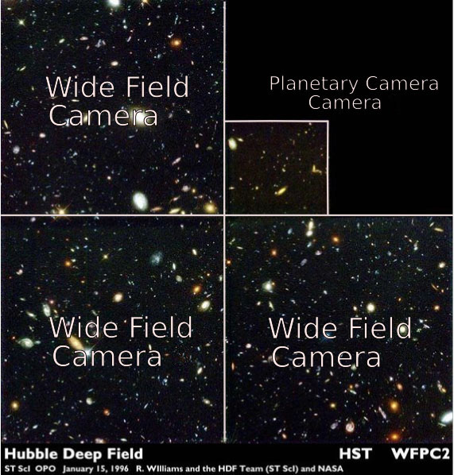
WFPC2
WFPC2 (Wide-Field Planetary Camera 2)
Ultraviolet (UV): ~120 nm – 400 nm
Visible: ~400 nm – 700 nm
Near-Infrared (NIR): ~700 nm – 1000 nm

Slide 3
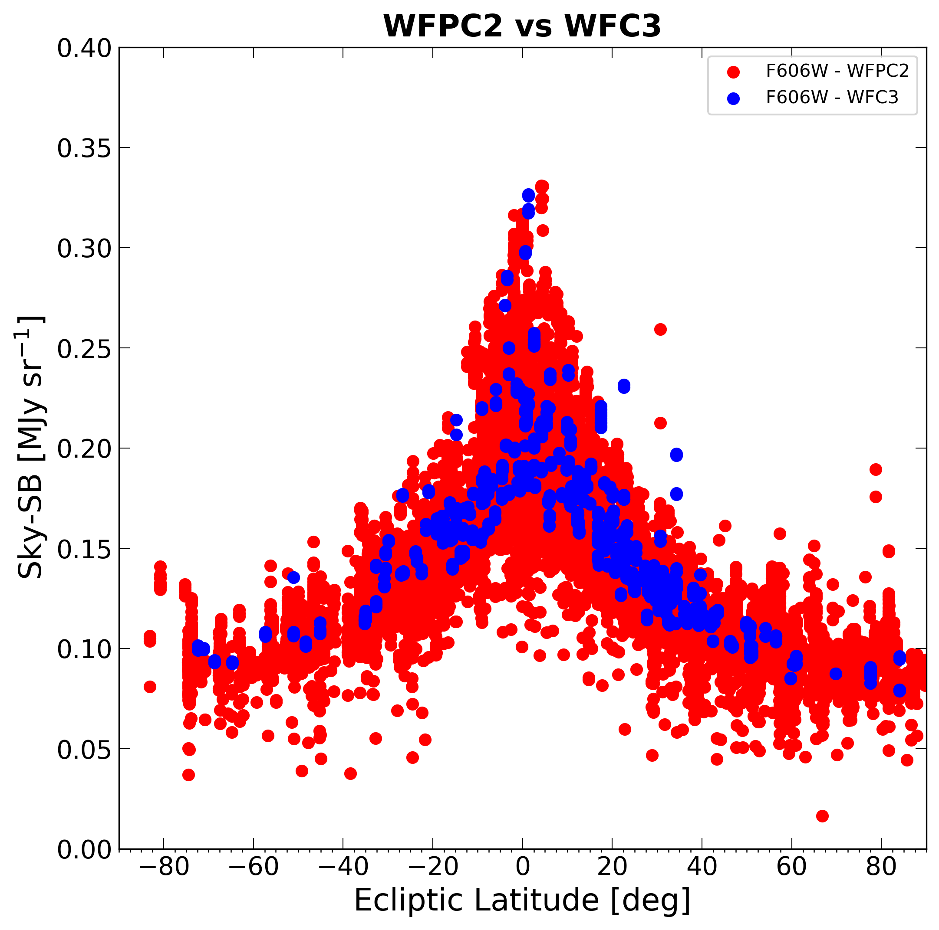
Comparing WFPC2 measurements to WFC3
Wavelength = 0.6 microns
WFPC2 yields significantly more noise – this is likely due to Mean Glow
Step 1): Attain Sky-SB (Surface Brightness Measurements)

Slide 4
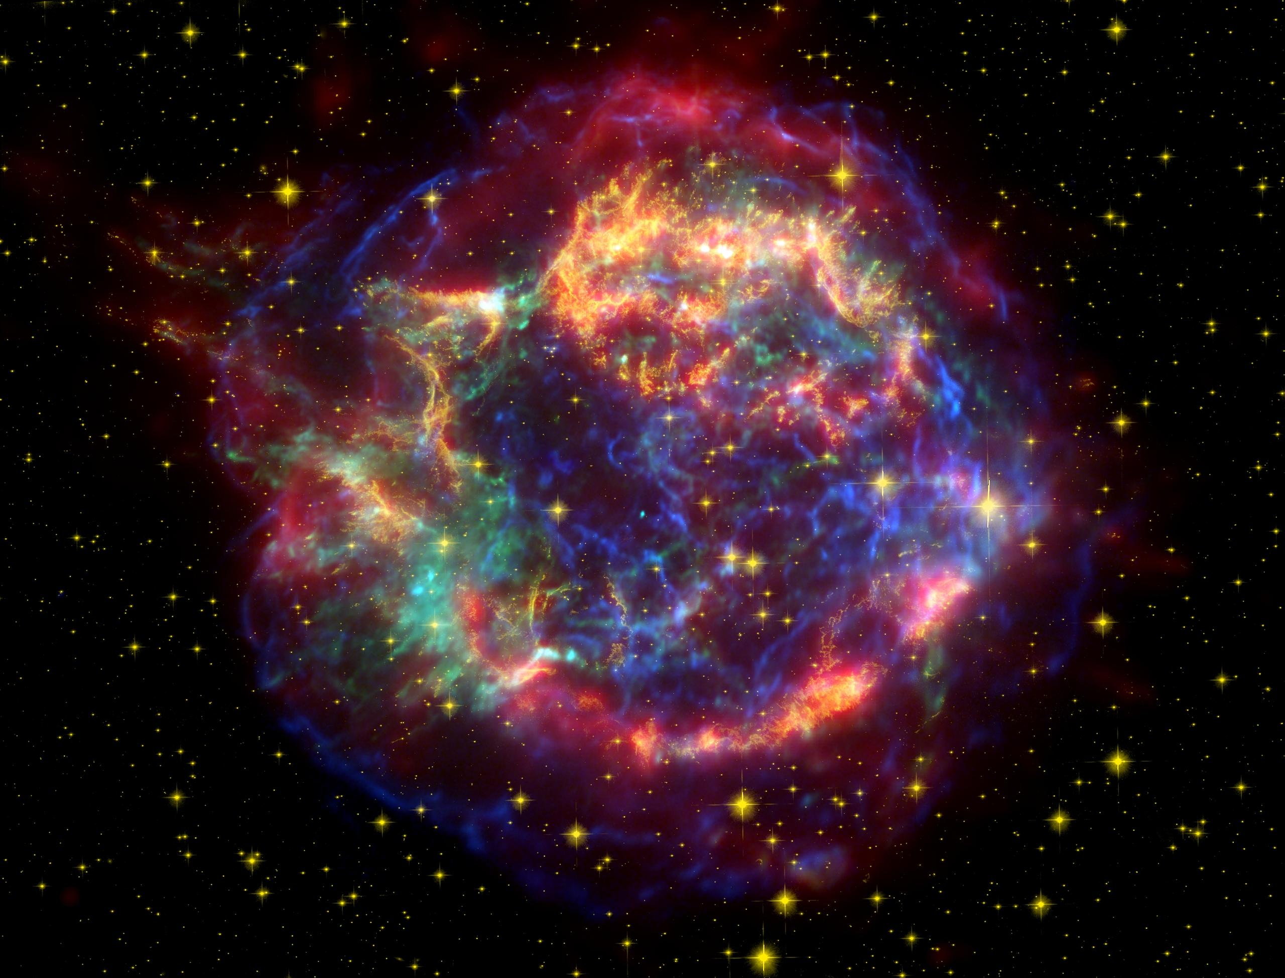
Cosmic Rays & Mean Glow
Emitted radiation bleeds into images as Cosmic Rays hit the CCD
Contamination measurable
Goal: measure Mean Glow by identifying Cosmic Rays

Slide 5
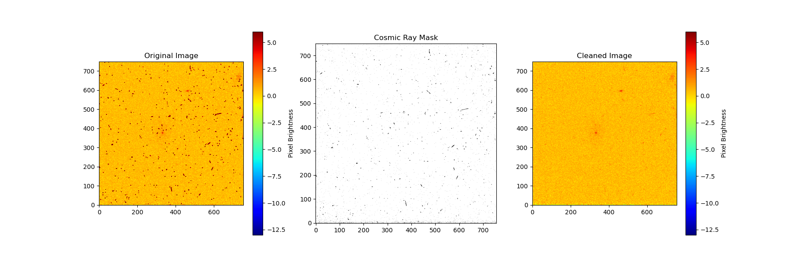
Identifying Cosmic Rays with LACosmic
Step 2): mask flagged Cosmic Ray Pixels utilizing LACosmic pixel measurement techniques

Slide 6
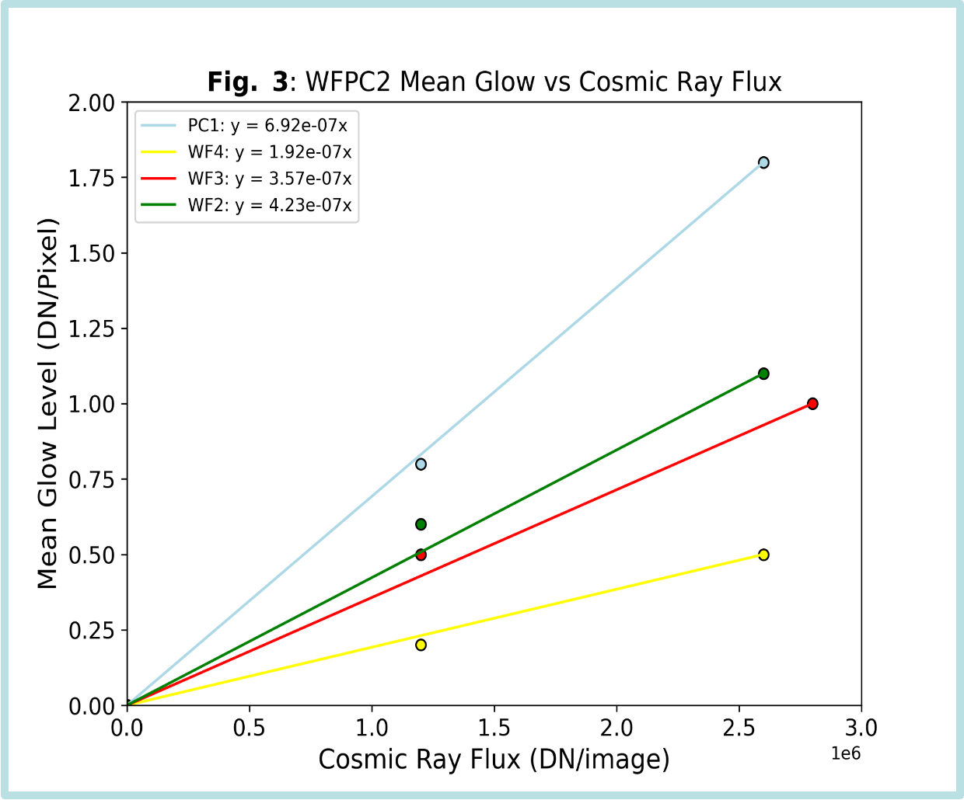
Measuring Dark Glow
Step 3): Construct basic model to calculate Mean Glow vs Cosmic Ray Flux
Mean Glow corrected Sky Surface Brigtness measurements will supplement measurements with other Hubble cameras

Slide 7
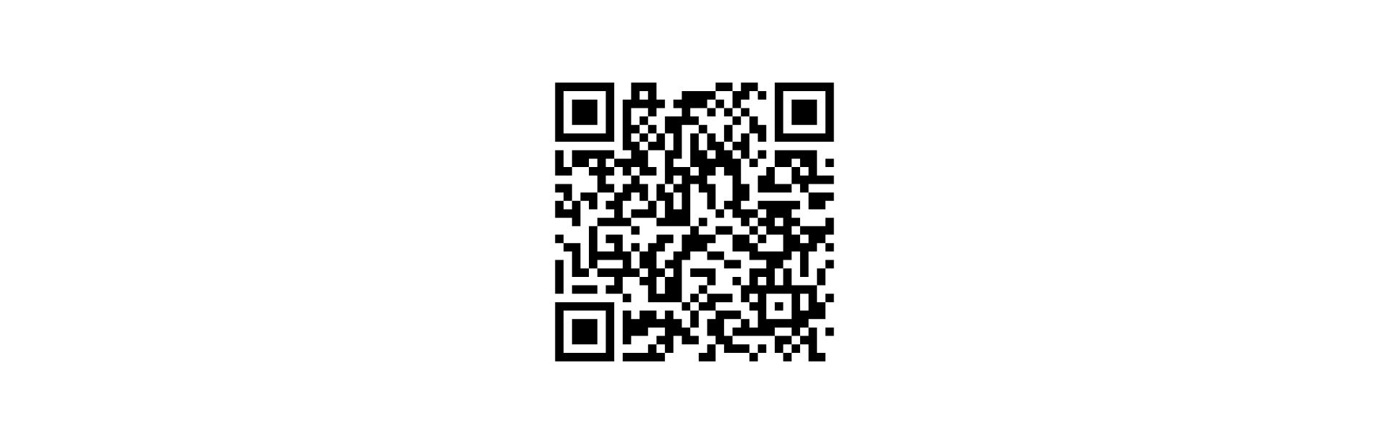
Conclusions
WFPC2 is one of HST’s previous cameras
Cosmic Rays hitting WFPC2 can contaminate measurements of the Sky-Surface Brightness, referred to as ‘Mean Glow’
We are estimating Mean Glow by measuring the amount of Cosmic Rays per Detector
For further information, reference O’Brien et al. 2023 (QR code)

Slide 8
Acknowledgements
Special thanks to:
Rosalia O’Brien, Professor Rogier Windhorst, Dr. Timothy Carleton, Dr. Rolf Jansen, Dr. Seth Cohen, Ralph Ortiz, Gibson Bowling
The SKYSURF team and collaborators
An extended thanks to NASA Space Grant
Lastly, shoutout to Desiree Crawl for helping manage and facilitate our NASA Space Grant this semester!!!

